Slide 1




Presentation by: Jacob Odey Adventure Works Report
View in Power BI
Date
9/25/2024

Slide 2
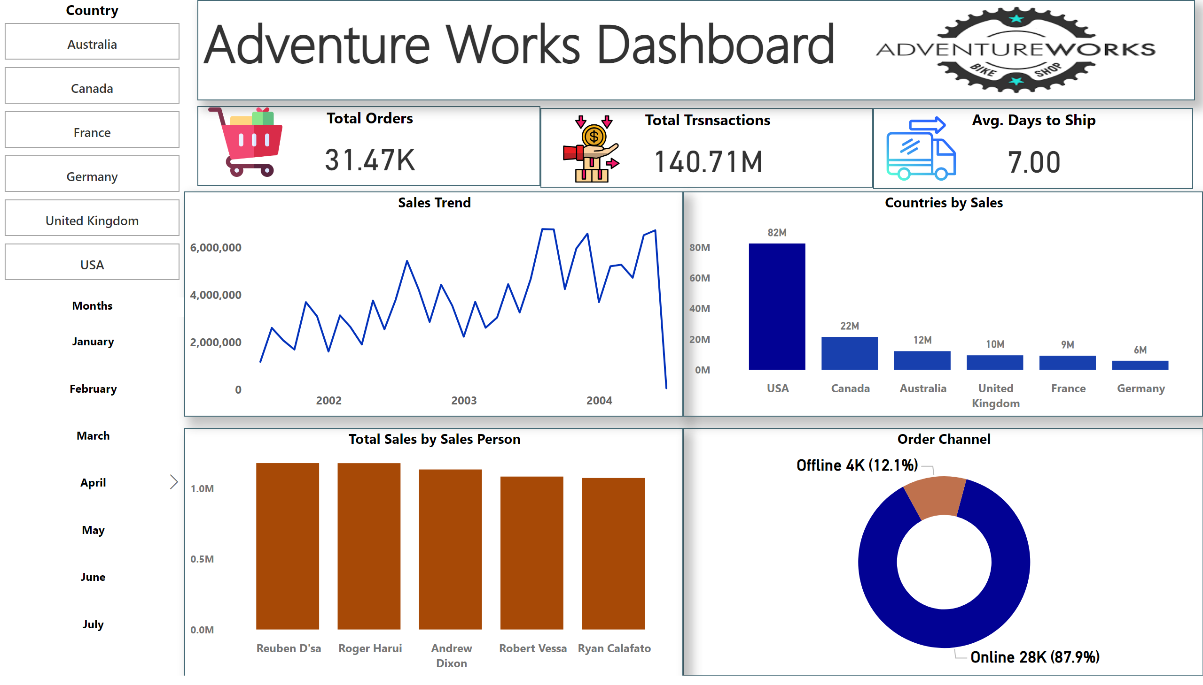
Dashboard
Notes:
Total Orders
No alt text provided
Total Trsnsactions
No alt text provided
Sales Trend
No alt text provided
textbox
No alt text provided
Avg. Days to Ship
No alt text provided
image
No alt text provided
image
No alt text provided
image
No alt text provided
image
No alt text provided
Order Channel
No alt text provided
Total Sales by Sales Person
No alt text provided
Countries by Sales
No alt text provided
Country
No alt text provided
Months
No alt text provided

Slide 3



Our Global Expedition
Our bicycle company has been on an incredible ride, crossing borders and connecting with customers globally. We've fulfilled over 31,470 orders since adventures started.
Total Transactions: $140.71M
7 days average to deliver those dreams
Key insight: Each order averages $4,470, indicating high-value products
Challenge: Can we reduce this to gain a competitive advantage?

Slide 4
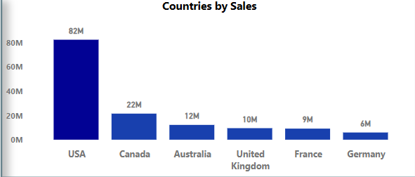
The World Map of Adventure Works
USA leads with $82M in sales
Significant presence in Canada, Australia, and Europe
Significant presence in Canada, Australia, and Europe
Opportunity: Expand market share in European countries

Slide 5
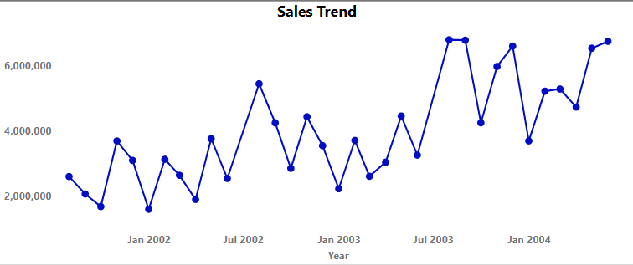
The Peaks and Valleys of Our Journey
Consistent growth from 2002 to 2004 where the longest period of growth is between 2001 and 2003.
Reached new heights in 2004 and still climbing.
The trend appears to be generally increasing over time, with some fluctuations.
Recommendations:
Seasonal fluctuations present opportunities for targeted campaigns

Slide 6
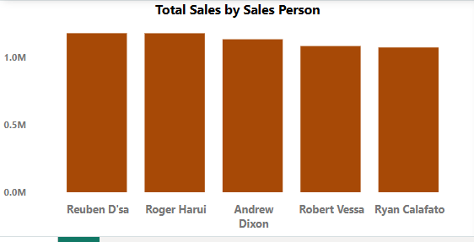
The Champions Driving Our Success
Top performers: Reuben D'sa and Roger Harui
Strategy: Analyze their methods for company-wide implementation

Slide 7
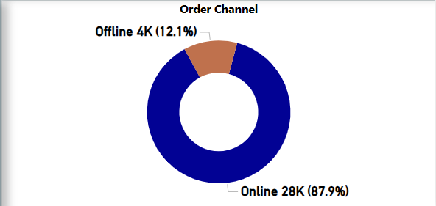
The Digital Revolution and Our Next Expedition
Online orders dominate with 28K (87.9%)
Offline orders account for 4K (12.1%)
Strategy: How do we enhance our digital highway while ensuring our traditional paths remain well-maintained?
Opportunity: Optimize the 12.1% offline orders

Slide 8
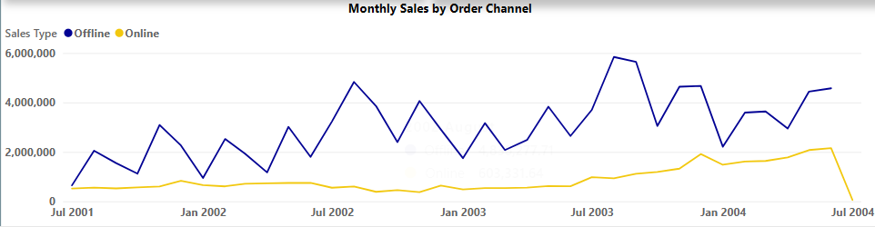
The Two Paths to Our Customers
In our quest to reach cyclists everywhere, we've discovered two distinct trails: the traditional offline path and the digital highway.
See how our offline sales, in blue, have been our trusted steed, carrying us through ups and downs? But don't miss that golden line of online sales. It's been steadily climbing, like a determined cyclist on a long uphill stretch.
Interestingly, as we approach mid-2004, these paths seem to converge. Are we witnessing a shift in how our customers prefer to shop? This crossroads presents both a challenge and an opportunity for our future strategy.

Slide 9
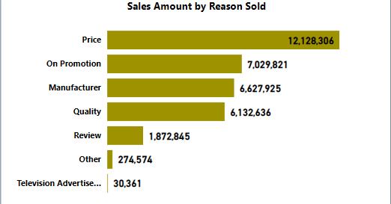
Why Customers Choose Us
Now, let's understand what makes our customers' wheels turn. Price leads the pack, showing that value matters most to our riders. But look closely - factors like promotions, manufacturer reputation, and quality follow closely behind.
It's like a well-oiled bike: price may be the frame, but it's the combination of all parts that creates a smooth ride. Even reviews play a role, reminding us that word-of-mouth can propel us forward.
Interestingly, TV advertising seems to have the least impact. Perhaps it's time to shift gears in our marketing strategy

Slide 10
Connecting the Dots
As we piece together our story, a clear picture emerges:
Our overall sales are on an upward trajectory, despite some fluctuations.
We're at a critical juncture where online and offline sales are converging.
While price is key, a holistic approach considering promotions, quality, and reputation is crucial.

Slide 11
The Road Ahead
So, where do we go from here? Let's consider:
How can we leverage our online presence while maintaining our offline strength?
Should we refine our pricing strategy while enhancing other value propositions?
How might we reallocate our marketing budget for maximum impact?
Develop training programs based on top-performer practices and create targeted plans for underperforming countries
Highlight opportunities for improving performance in lower-performing countries
Shipping time optimization
Sales team best practices sharing
Remember, every great adventure requires adapting to the terrain. Are we ready to shift gears and tackle the road ahead?

Slide 12
Thank You!

